Slide 1
EUGDPR – Some Basics
Data subjects can ask you to give them access to the information that you are keeping on them (Art. 15 GDPR).
Explain
why you are collecting & processing the data,
what kind of data you are collecting,
where you got the data
how long you plan to keep that data.
People can ask to rectify or erase their personal data & they have the right to make a complaint to the supervisory authority.
If using artificial intelligence or automated logic to make decisions about them, you need to explain how the logic works.

Slide 2
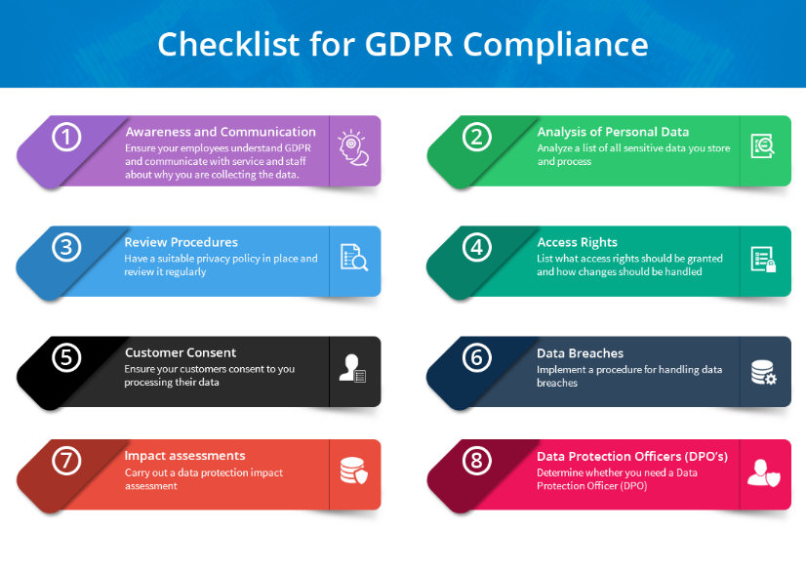
EUGDPR – Some Basics

